Slide 1

USAT Project Podium Metabolic Testing and Data Analysis Update

Slide 2
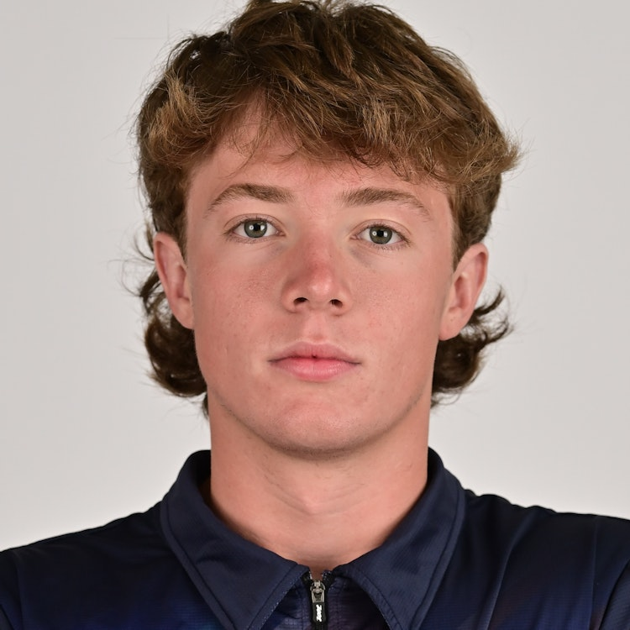
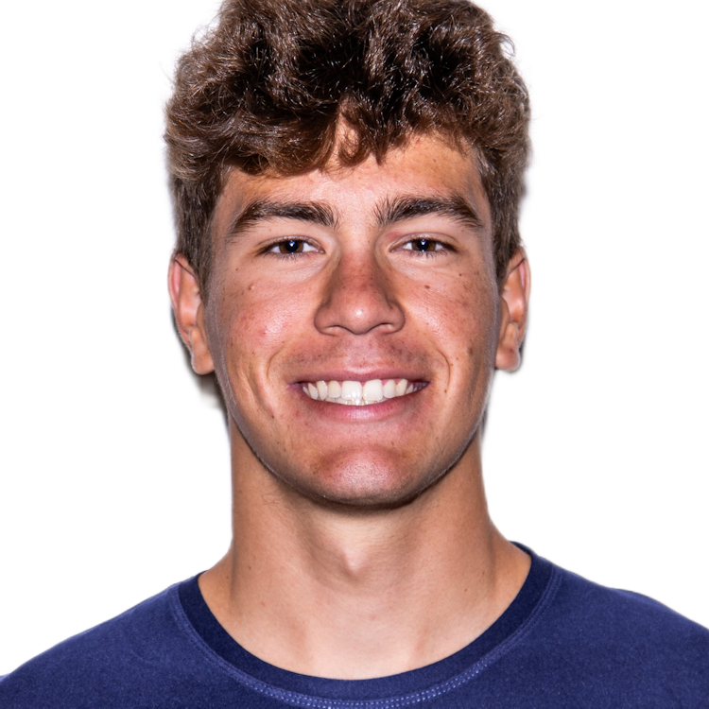
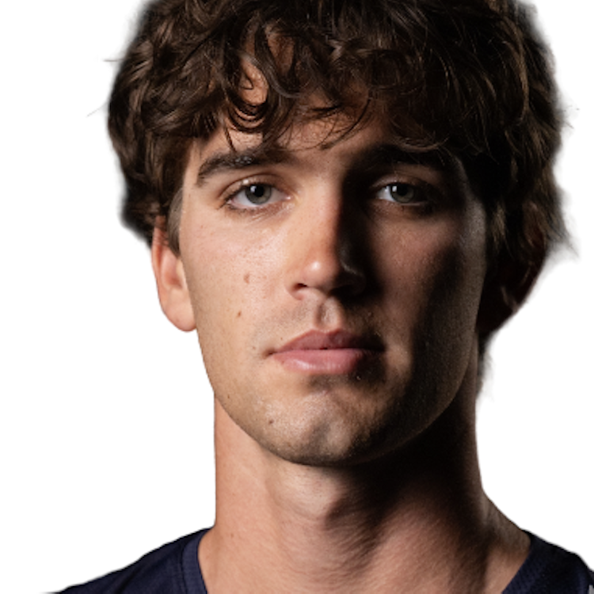
Individual Focus
Race Overview – WTCS Yokohama
WHO
Three top USAT athletes competing at the highest level, the World Triathlon Championship Series event in Yokohama.
WHAT
All three athletes came off the bike together in the main chase group. In this position, one of the athletes was most likely to have the best performance based on run testing and historical performances. Yet, he struggled on the run and finished 3rd among the group.
HOW
When analyzing the athletes bike data, the favored athlete’s file looks very similar to the others when isolating for average power. However, using simulation techniques we modelled out the favored athlete’s blood lactate levels and saw that he finished the bike far above his threshold, directly leading to poor run ability.
WHY
Without this data we may have believed the favored athlete to have lost significant run fitness. In contrast, this athlete’s run was more so affected by the surges on the bike that spiked his lactate. With more bike handling preparation and race awareness, we can help the athlete ride smarter to achieve his maximum run potential
Notes:
shape
No alt text provided
pageNavigator
No alt text provided
Gap to Lead by Stage
No alt text provided
Name
No alt text provided
Place Change by Stage
No alt text provided
Place at Stage
No alt text provided
pivotTable
No alt text provided
slicer
No alt text provided
slicer
No alt text provided
shape
No alt text provided
Key Point
No alt text provided
Recent Performance
No alt text provided
image
No alt text provided

Slide 3
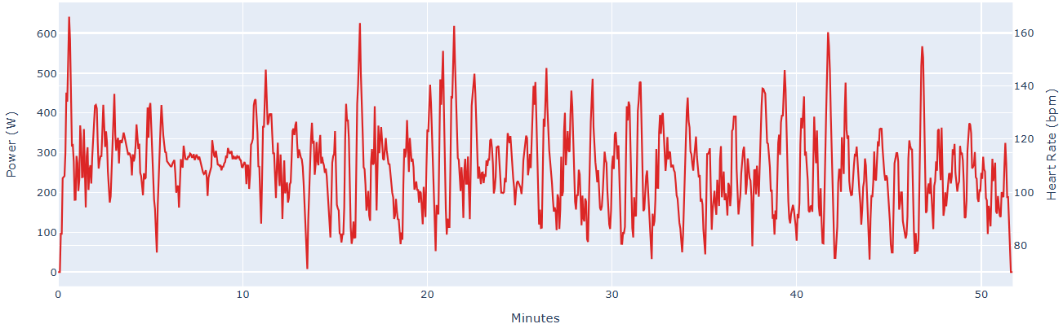
Individual Focus
Blake Bullard Yokohama Bike
Despite being in the breakaway, Blake minimized his surges over 600W once. Then when falling back into the main chase, Blake rode mostly around a medio effort keeping lactate below 4 mmol/kg
Raw Power File
Simulated Blood Lactate Concentration
Note: Power file shown with 2s smoothing for better visibility
Notes:
shape
No alt text provided
pageNavigator
No alt text provided
Gap to Lead by Stage
No alt text provided
Name
No alt text provided
Place Change by Stage
No alt text provided
Place at Stage
No alt text provided
pivotTable
No alt text provided
slicer
No alt text provided
slicer
No alt text provided
shape
No alt text provided
Key Point
No alt text provided
Recent Performance
No alt text provided
image
No alt text provided

Slide 4
Individual Focus
Blake Bullard Yokohama Bike
Blake began the bike in a small 7-man breakaway coming out of the water yet had his highest spikes in lactate once he had been dropped and settled into the main chase group. This suggests that Blake needs to continue working on bike skills rather than pure power numbers
Blake relatively even pacing resulted in a VI of 1.08, always keeping lactate below 4 mmol/kg and even dropped it all the way below 2 mmol/kg before starting the run
Simulated Blood Lactate Concentration
Bike Metrics
Average Power | 259 W
Average Power w/o 0’s | 290 W
Normalized Power | 279 W
Variability Index | 1.08
Ending LaB – 1.3
Notes:
shape
No alt text provided
pageNavigator
No alt text provided
Gap to Lead by Stage
No alt text provided
Name
No alt text provided
Place Change by Stage
No alt text provided
Place at Stage
No alt text provided
pivotTable
No alt text provided
slicer
No alt text provided
slicer
No alt text provided
shape
No alt text provided
Key Point
No alt text provided
Recent Performance
No alt text provided
image
No alt text provided

Slide 5
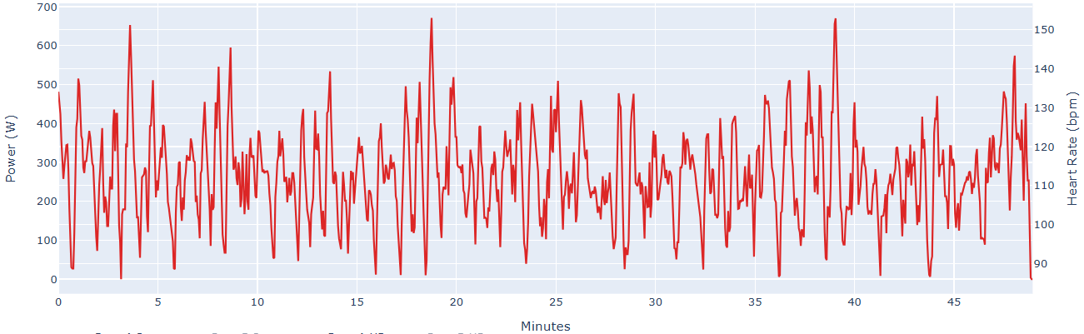
Individual Focus
Braxton Legg Yokohama Bike
As a taller athlete, Braxton is a bit heavier, but also has the highest threshold among the three. Despite an ability to hold higher power, Braxton minimized his surges over 600W to only 3 times during the ride. This kept his lactate below 4 mmol/kg for the whole effort.
Raw Power File
Simulated Blood Lactate Concentration
Note: Power file shown with 2s smoothing for better visibility
Notes:
shape
No alt text provided
pageNavigator
No alt text provided
Gap to Lead by Stage
No alt text provided
Name
No alt text provided
Place Change by Stage
No alt text provided
Place at Stage
No alt text provided
pivotTable
No alt text provided
slicer
No alt text provided
slicer
No alt text provided
shape
No alt text provided
Key Point
No alt text provided
Recent Performance
No alt text provided
image
No alt text provided

Slide 6
Individual Focus
Braxton Legg Yokohama Bike
Braxton also rode a mostly consistent effort with a VI of 1.09, keeping any surges to a minimum and riding a large portion of the ride near his maximum lactate clearance zone
He finished the ride with lactate concentration of 2.06 and went on for his best run performance to date
Simulated Blood Lactate Concentration
Bike Metrics
Average Power | 267 W
Average Power w/o 0’s | 307 W
Normalized Power | 289 W
Variability Index | 1.09
Ending LaB – 2.06
Notes:
shape
No alt text provided
pageNavigator
No alt text provided
Gap to Lead by Stage
No alt text provided
Name
No alt text provided
Place Change by Stage
No alt text provided
Place at Stage
No alt text provided
pivotTable
No alt text provided
slicer
No alt text provided
slicer
No alt text provided
shape
No alt text provided
Key Point
No alt text provided
Recent Performance
No alt text provided
image
No alt text provided

Slide 7
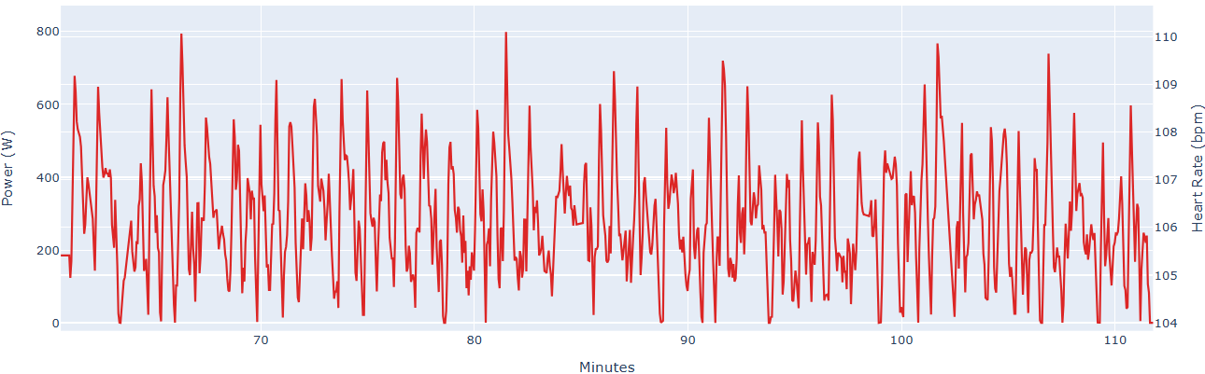
Individual Focus
Reese Vannerson Yokohama Bike
Reese spent significant time over 600 watts with several surges ~800 watts. This caused his lactate to rise significantly above threshold. Additionally, his bike positioning kept him from being able to ride his maximum lactate clearance wattage, keeping lactate high
Raw Power File
Simulated Blood Lactate Concentration
Note: Power file shown with 2s smoothing for better visibility
Notes:
shape
No alt text provided
pageNavigator
No alt text provided
Gap to Lead by Stage
No alt text provided
Name
No alt text provided
Place Change by Stage
No alt text provided
Place at Stage
No alt text provided
pivotTable
No alt text provided
slicer
No alt text provided
slicer
No alt text provided
shape
No alt text provided
Key Point
No alt text provided
Recent Performance
No alt text provided
image
No alt text provided

Slide 8
Individual Focus
Reese Vannerson Yokohama Bike
Despite a similar average power as Blake and Braxton, Reese had a higher Variability Index of 1.14 demonstrating the surges within his ride
With an ending blood lactate value of 8.21, Reese was significantly over threshold beginning the run
Simulated Blood Lactate Concentration
Bike Metrics
Average Power | 274 W
Average Power w/o 0’s | 314 W
Normalized Power | 312 W
Variability Index | 1.14
Ending LaB – 8.21
Notes:
shape
No alt text provided
pageNavigator
No alt text provided
Gap to Lead by Stage
No alt text provided
Name
No alt text provided
Place Change by Stage
No alt text provided
Place at Stage
No alt text provided
pivotTable
No alt text provided
slicer
No alt text provided
slicer
No alt text provided
shape
No alt text provided
Key Point
No alt text provided
Recent Performance
No alt text provided
image
No alt text provided

Slide 9
Individual Focus
Blake Bullard Yokohama Run
Using Blake’s Garmin watch we can simulate Blood Lactate using velocity as a proxy for the demands of the effort.
Potential limitations of velocity may include lack of air resistance, elevation, and other environmental factors in the race that effect run speed but not necessarily power (effort).
Simulated Blood Lactate Concentration
Run Metrics
Time | 32:12
Distance | 6.37
Average Pace | 4:57
NGP | 4:58
Ending LaB – 3.4
Notes:
shape
No alt text provided
pageNavigator
No alt text provided
Gap to Lead by Stage
No alt text provided
Name
No alt text provided
Place Change by Stage
No alt text provided
Place at Stage
No alt text provided
pivotTable
No alt text provided
slicer
No alt text provided
slicer
No alt text provided
shape
No alt text provided
Key Point
No alt text provided
Recent Performance
No alt text provided
image
No alt text provided

